Slide 1
Presentation on Digital Computer & Organization
Made By:-
Ashvin jain
IC-2K18-11

Slide 2
Index :
Introduction
Input - Output Organization
Memory Organization
CPU Organization
Control Unit

Slide 3
Introduction
Computer organization and architecture mainly focuses on various parts of the computer in order to reduce the execution time of the program, improve the performance of each part. Generally, we tend to think computer organization and computer architecture as same but there is slight difference.

Slide 4
Computer organization
Computer organization is concerned with the way the hardware components operate and the way they are connected together to form the computer system.
The various components are assumed to be in place and the task is to investigate the organizational structure to verify that the computer parts operate as intended.

Slide 5
Computer architecture
Computer architecture is concerned with the structure and behavior of the computer as seen by the user.
It includes the information formats, the instruction set, and techniques for addressing memory.
The architectural design of a computer system is concerned with the specifications of the various functional modules, such as processors and memories, and structuring them together into a computer system
Computer Architecture is the field of study of selecting and interconnecting hardware components to create computers that satisfy functional performance and cost goals.
It refers to those attributes of the computer system that are visible to a programmer and have a direct effect on the execution of a program.

Slide 6
Difference
Computer Organization is study of the system from software point of view and gives overall description of the system and working principles without going into much detail. In other words, it is mainly about the programmer’s or user point of view.
Computer Architecture is study of the system from hardware point of view and emphasis on how the system is implemented. Basically, throws light on the designer’s point of view.

Slide 7
Von Neumann Architecture
Stored program concept.
The modern computers are based on a stored-program concept introduced by John Von Neumann.
programs and data are stored in a separate storage unit called memories
ALU operating on binary data.
Control unit interpreting instruction from memory and executing.
Input and Output equipment operated by control unit.

Slide 8
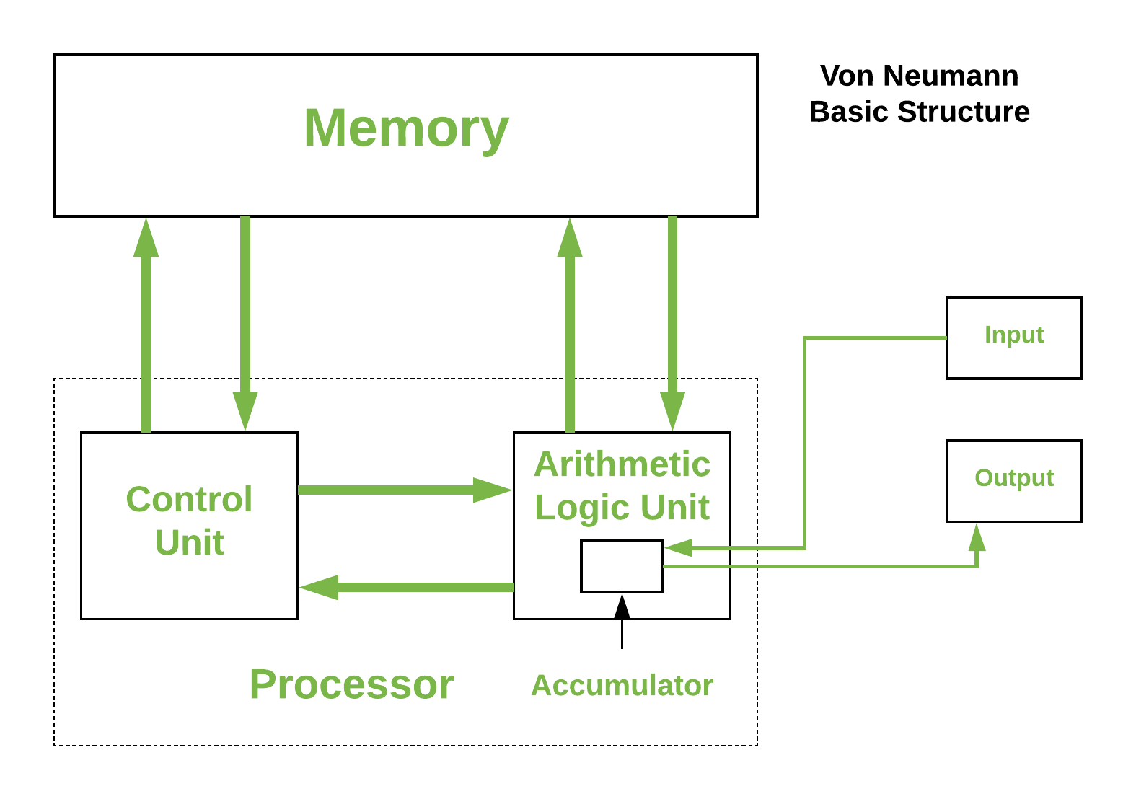

Slide 9
It is also known as IAS computer and is having three basic units:
1.) The Central Processing Unit (CPU)
2.)The Main Memory Unit
3.)The Input / Output Device

Slide 10
Control unit & ALU
Control Unit
A control unit (CU) handles all processor control signals. It directs all input and output flow, fetches code for instructions and controlling how data moves around the system.
Arithmetic and Logic Unit (ALU)
The arithmetic logic unit is that part of the CPU that handles all the calculations the CPU may need, e.g. Addition, Subtraction, Comparisons. It performs Logical Operations, Bit Shifting Operations, and Arithmetic Operation.

Slide 11
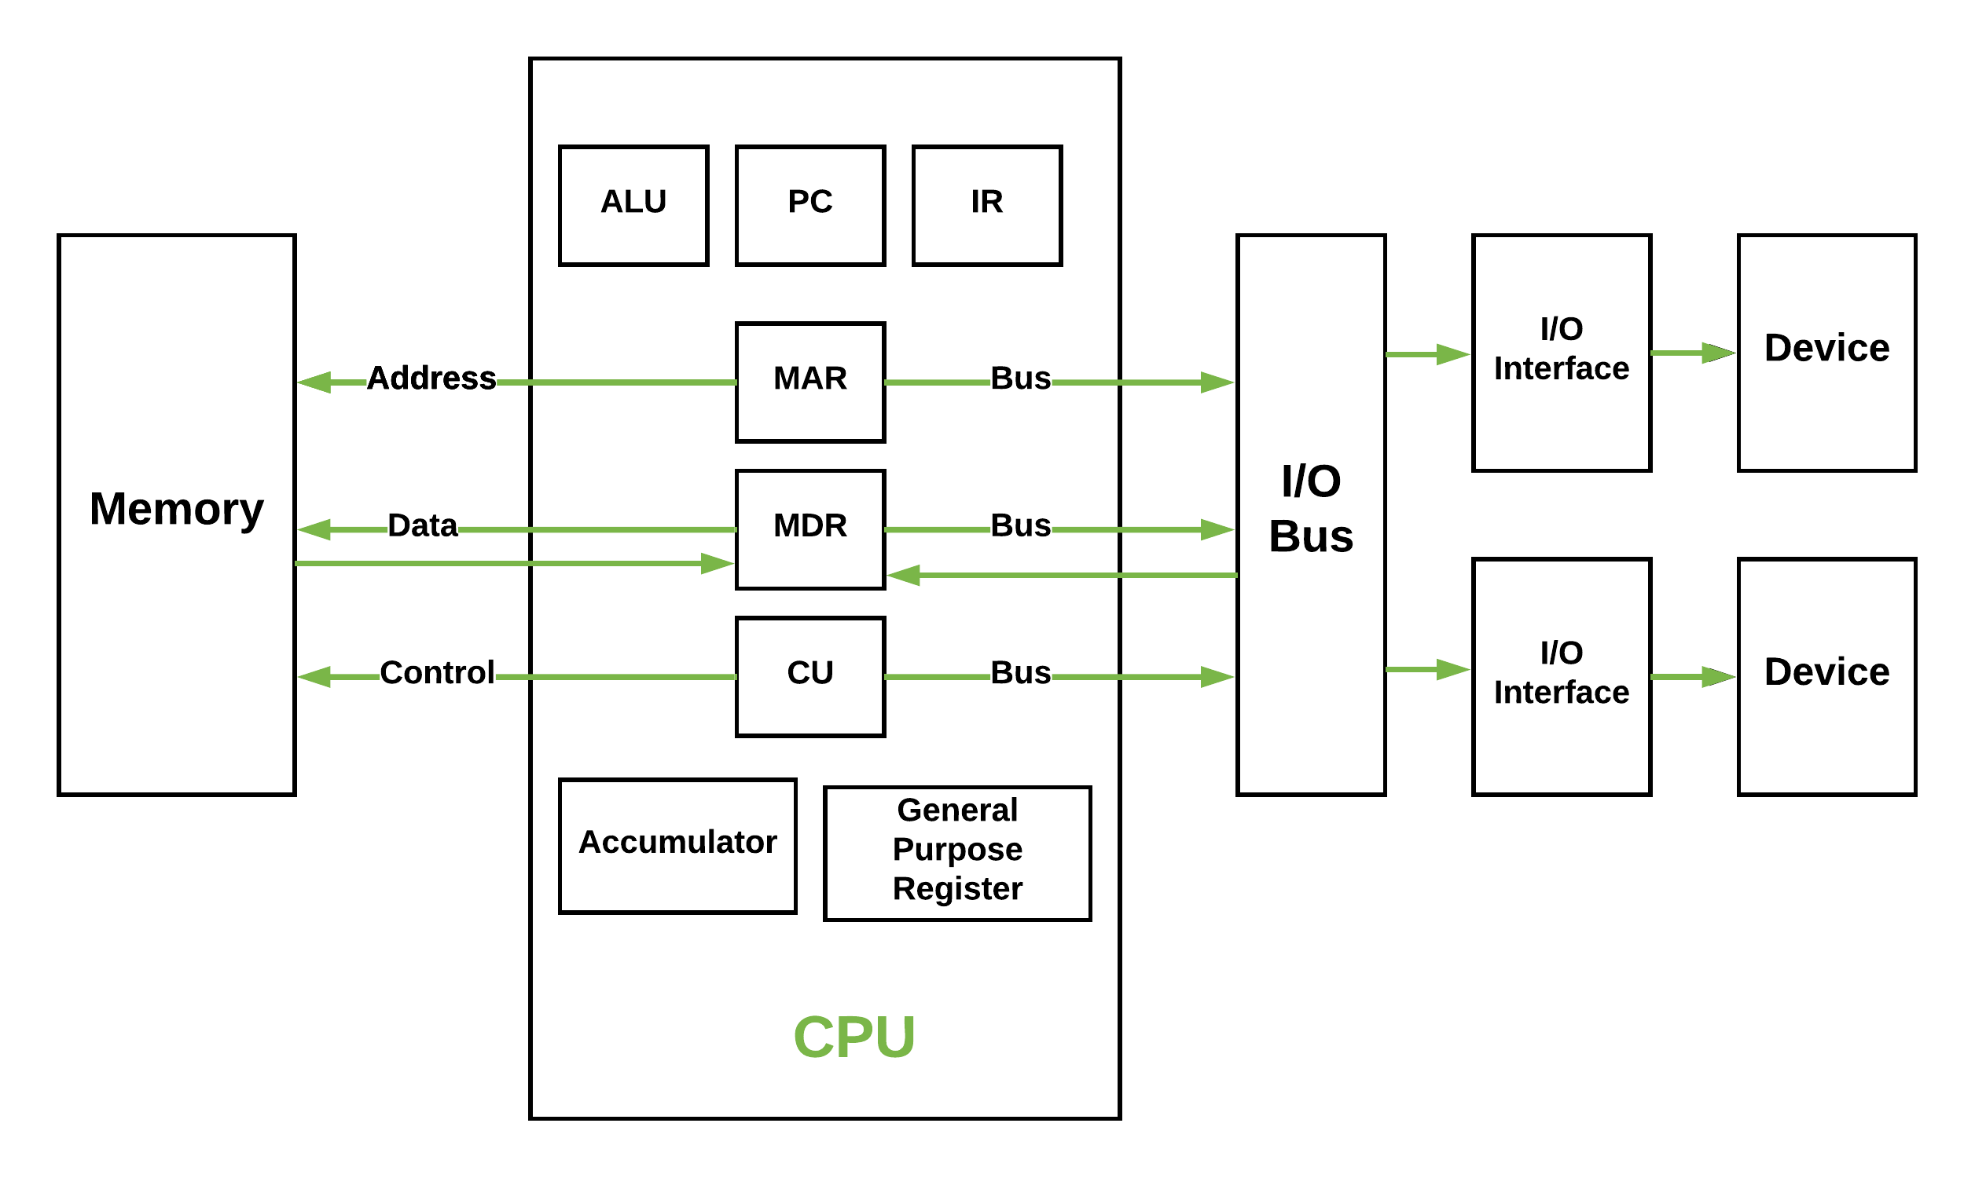
Basic CPU structure, illustrating ALU

Slide 12
Main Memory Unit (Registers)
Accumulator
Stores the results of calculations made by ALU.
Program Counter (PC)
Keeps track of the memory location of the next instructions to be dealt with. The PC then passes this next address to Memory Address Register (MAR).
Memory Address Register (MAR)
It stores the memory locations of instructions that need to be fetched from memory or stored into memory.
Memory Data Register (MDR)
It stores instructions fetched from memory or any data that is to be transferred to, and stored in, memory.
Current Instruction Register (CIR)
It stores the most recently fetched instructions while it is waiting to be coded and executed.
Instruction Buffer Register (IBR)
The instruction that is not to be executed immediately is placed in the instruction buffer register IBR.

Slide 13
Input / Output Devices
Program or data is read into main memory from the input device or secondary storage under the control of CPU input instruction. Output devices are used to output the information from a computer. If some results are evaluated by computer and it is stored in the computer, then with the help of output devices, we can present it to the user.

Slide 14
Buses
Data is transmitted from one part of a computer to another, connecting all major internal components to the CPU and memory, by the means of Buses.
Data Bus
It carries data among the memory unit, the I/O devices, and the processor.
Address Bus
It carries the address of data (not the actual data) between memory and processor.
Control Bus
It carries control commands from the CPU (and status signals from other devices) in order to control and coordinate all the activities within the computer.

Slide 15
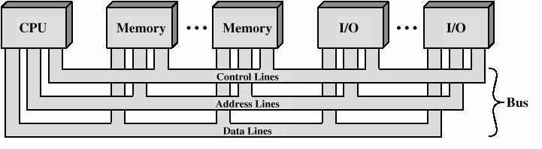

Slide 16
Input - Output Organization

Slide 17
The input-output subsystem of a computer provides an efficient mode of communication between the central system and the outside environment. It handles all the input-output operations of the computer system.
PERIPHERALS:- Input or output devices that are connected to computer are called peripheral devices. These devices are designed to read information into or out of the memory unit upon command from the CPU and are considered to be the part of computer system. These devices are also called peripherals

Slide 18
Three Type Of Peripherals
Input Peripherals- An input device is a peripheral(piece of computer hardware equipment) used to provide data and control signals to an information processing system such as a computer or other information appliance.
Output Peripherals-An output device is any peripheral that receives data from a computer, usually for display, projection, or physical reproduction.
Input-output Peripherals-The I/O (input and output) peripheral are used primarily for communication between the computer and the external environment. They provide the ability to enter commands to the PC, and vice versa, i.e. send commands to outside to perform some task on a given device.

Slide 19
Interrupt Driven I/O
Interrupt driven I/O is an alternative scheme dealing with I/O. Interrupt I/O is a way of controlling input/output activity whereby a peripheral or terminal that needs to make or receive a data transfer sends a signal. This will cause a program interrupt to be set. At a time appropriate to the priority level of the I/O interrupt. Relative to the total interrupt system, the processors enter an interrupt service routine. The function of the routine will depend upon the system of interrupt levels and priorities that is implemented in the processor. The interrupt technique requires more complex hardware and software, but makes far more efficient use of the computer’s time and capacities. Figure 2 shows the simple interrupt processing.

Slide 20
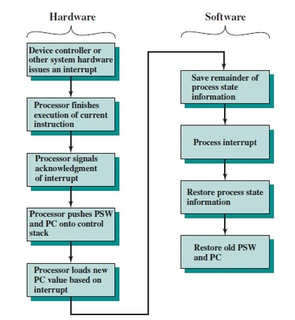

Slide 21
Priority Interrupt
Priority Interrupt are systems, that establishes a Priority over the various sources(interrupt devices) to determine which condition is to be serviced first when two or more requests arrive simultaneously . This system may also determine which condition are permitted to interrupt to the computer while another interrupt is being serviced . Usually, in Priority Systems, higher-priority interrupt levels are served first, as if they delayed or interrupted, could have serious consequences . And the devices with high-speed transfer such as magnetic disks are given high-priority, and slow devices such as keyboards receives low-priority.

Slide 22
Direct Memory Access
DMA stands for "Direct Memory Access" and is a method of transferring data from the computer's RAM to another part of the computer without processing it using the CPU. While most data that is input or output from your computer is processed by the CPU, some data does not require processing, or can be processed by another device. n these situations, DMA can save processing time and is a more efficient way to move data from the computer's memory to other devices. In order for devices to use direct memory access, they must be assigned to a DMA channel. Each type of port on a computer has a set of DMA channels that can be assigned to each connected device. For example, a PCI controller and a hard drive controller each have their own set of DMA channels.

Slide 23
I/O Processor
An input-output processor (IOP) is a processor with direct memory access capability. In this, the computer system is divided into a memory unit and number of processors.
Each IOP controls and manage the input-output tasks. The IOP is similar to CPU except that it handles only the details of I/O processing. The IOP can fetch and execute its own instructions. These IOP instructions are designed to manage I/O transfers only.

Slide 24
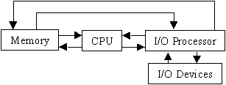

Slide 25
Synchronous Data Transfer
In Synchronous data transfer, the sending and receiving units are enabled with same clock signal. It is possible between two units when each of them knows the behavior of the other. The master performs a sequence of instructions for data transfer in a predefined order. All these actions are synchronized with the common clock. The master is designed to supply the data at a time when the slave is definitely ready for it. Usually, the master will introduce sufficient delay to take into account the slow response of the slave, without any request from the slave

Slide 26
Asynchronous Data Transfer
In most computer asynchronous mode of data transfer is used in which two component have a different clock. Data transfer can occur between data in two ways serial and parallel. In case of parallel multiple lines are used to send a single bit whereas in serial transfer each bit is send one at a time. To tell other devices when the character/data will be given a concept of start and end bit is used. A start bit is denoted by 0 and stop bit is detected when line return to 1-state at least one time, here 1-state means that there is not data transfer is occurring.

Slide 27
Strobe Control
In computer or memory technology, a strobe is a signal that is sent that validates data or other signals on adjacent parallel lines. In memory technology, the CAS (column address strobe) and RAS ( row address strobe ) signals are used to tell a dynamic RAM that an address is a column or row address.

Slide 28
Working principle of keyboard
Working Principle of a Keyboard:-Inside the keyboard, there are metallic plate, circuit board and processor, which are responsible for transferring information from the keyboard to the computer. Depending upon the working principle, there are two main types of keys, namely, capacitive and hard-contact. Let's discuss in brief about the functioning of capacitive and hard contact key . When a capacitive key is pressed, the metal plunger applies a gentle pressure to the circuit board. The pressure is identified by the computer and the circuit flow is initiated, resulting in the transfer of information from the circuit to the currently installed software. The key identifying to computer is identified using a keyboard driver and finding the preferred key called source code.

Slide 29
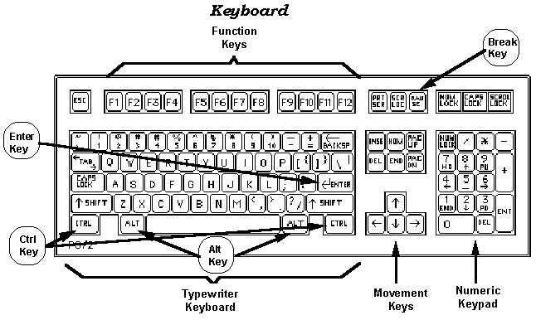

Slide 30
Working Mechanism Of Scanner
Scanners operate by shining light at the object or document being digitized and directing the reflected light (usually through a series of mirrors and lenses) onto a photosensitive element. In most scanners, the sensing medium is an electronic, light-sensing integrated circuit known as a charged coupled device (CCD). Light-sensitive photosites arrayed along the CCD convert levels of brightness into electronic signals that are then processed into a digital image.

Slide 31
CCD is by far the most common light-sensing technology used in modern scanners. Two other technologies, CIS (Contact Image Sensor), and PMT (photomultiplier tube) are found in the low and high ends of the scanner market, respectively. CIS is a newer technology that allows scanners to be smaller and lighter, but sacrifices dynamic range, depth-of-field, and resolution. PMT-based drum scanners produce very high-quality images.
Another sensing technology, CMOS (Complementary Metal Oxide Semiconductor), appears primarily in low-end, hand-held digital cameras where its low cost, low power consumption and easier component integration permits smaller, less expensive designs. Traditionally, high-end and professional digital cameras employ CCD sensors, despite their expense and the complexity of their design, because they exhibit much superior noise characteristics. Although some innovative designs that render low-noise CMOS-based images are emerging, CCD still dominates the high end of the market.

Slide 32
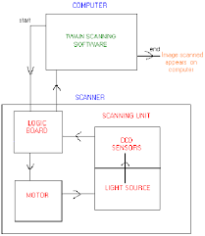

Slide 33
Touch Screen Panel
Touch screen technology is the direct manipulation type gesture based technology. Direct manipulation is the ability to manipulate digital world inside a screen. A Touch screen is an electronic visual display capable of detecting and locating a touch over its display area. This is generally refers to touching the display of the device with a finger or hand. This technology most widely used in computers, user interactive machines, smart phones, tablets etc to replace most functions of the mouse and keyboard.

Slide 34
Types of Touch Screen Technology
The Touch screen is a 2-dimensional sensing device made of 2 sheets of material separated by spacers. There are four main touch screen technologies:
Resistive.
Capacitive .
Surface Acoustical wave (SAW).
Infrared (IR).

Slide 35
Resistive
Resistive touch screen is composed of a flexible top layer made of polythene and a rigid bottom layer made of glass separated by insulating dots, attached to a touch screen controller. Resistive touch screen panels are more affordable but offering only 75% of light monitor and the layer can be damaged by sharp objects. Resistive touch screen is further divided into 4-, 5-, 6-, 7-, 8- wired resistive touch screen. The construction design of all these modules is similar but there is a major distinction in each of its method to determine the coordinates of touch.

Slide 36
CAPACITIVE
A capacitive touch screen panel is coated with a material that stores electrical charges. The capacitive systems can transmit up to 90% of light from the monitor. It is divided into two categories. In Surface-capacitive technology only one side of the insulator is coated with a conducting layer. Whenever a human finger touches the screen, conduction of electric charges occurs over the uncoated layer which results in the formation of dynamic capacitor. The controller then detects the position of touch by measuring the change in capacitance at the four corners of the screen.

Slide 37
Surface Acoustic wave
The surface acoustic wave technology
contains two transducers placed along X axis and Y-axis of the monitor’s glass plate along with some reflectors. When the screen is touched, the waves are absorbed and a touch is detected at that point. These reflectors reflect all electrical signals sent from one transducer to another. This technology provides excellent through put and quality.

Slide 38
Infrared
In infrared touch screen technology, an array of X and Y axis is fitted with pairs of IR Leds and photo detectors. Photo detectors will detect any image in the pattern of light emitted by the Leds whenever the user touches the screen.

Slide 39
Working mechanism of touch screen panel
A basic touch screen is having a touch sensor, a controller, and a software driver as three main components. The touch screen is needed to be combined with a display and a PC to make a touch screen system.
Touch sensor:The sensor generally has an electrical current or signal going through it and touching the screen causes a change in the signal. This change is used to determine the location of the touch of the screen.

Slide 40
Controller: A controller will be connected between touch sensor and PC. It takes information from sensor and translates it for understanding of PC. The controller determines what type of connection is needed.
Software driver : It allows computer and touch screen to work together. It tells OS how to interact the touch event information that is sent from the controller.

Slide 41
MEMORY
ORGANISATION

Slide 42
MEMORY HIERARCHY
The memory hierarchy design in a computer system mainly includes different storage devices. Most of the computers were inbuilt with extra storage to run more powerfully beyond the main memory capacity. The following memory hierarchy diagram is a hierarchical pyramid for computer memory. The designing of the memory hierarchy is divided into two types such as primary (Internal) memory and secondary (External) memory.

Slide 43
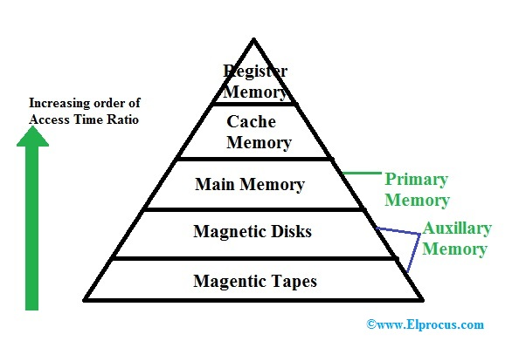

Slide 44
Memory
Memory is used to store programs and data.
Types of memory :-
1. Primary Memory
I. ROM (Read Only Memory)
A. Masked ROM. B. PROM.
C. EPROM. D. EEPROM.
II. RAM (Random Access Memory)
A. SRAM B.DRAM

Slide 45
Primary Memory
The memory with which the CPU can directly communicate is called primary memory.
Primary memory is also called as main memory.
Available as semiconductor chips , therefore also called as semiconductor memory.
The CPU takes instruction from this memory and execute it.
Main Memory and CPU both perform parallel data transfer.

Slide 46
ROM (Read Only Memory)
The content of this memory can be read only.
The program written in the ROM cannot be modified by the user or programmer.
ROM is also available in semiconductor chips.
Organized as group of equal-sized addressable registers.
Address of particular register is applied to a particular ROM chip, then a control signal “read” is provided by the CPU to read a content of that register.
ROM is used to hold some permanent program and some fixed data.
ROM is a Permanent or non-volatile memory.

Slide 47
Masked-ROM
This is factory programmed ROM. A program is written into this ROM while Fabrication.
Once the program is written it can not be changed.
If a new program is to be written a new masked-ROM is needed.
Masted ROMs are extensively used in embedded control system in which a permanent program resides in the ROM.
This program need not to be modified .Therefore, masked is referred to as “Program Memory”.

Slide 48
PROM
This chip comes blank from the factory.
It contain diode as fusible links.
A program can be written by a device called PROM programmer.
This device provides heavy current for fusing a link.
Once the program is written it can not be erased.

Slide 49
EPROM
EPROM is made up of MOSFET cells in which the information is stored in the form of charge.
EPROM also come blank from factory.
It can be programmed by a device called EPROM programmer.
If we want to erase the content of EPROM an UV light source is put for 20 minutes to do this.
The problem with this type is that the whole program is erased, not one or few memory locations.

Slide 50
EEPROM
Electrical pulse are used to erase the content of this chip.
This chip is also known as EAPROM (Electrically Alterable PROM) because we can select one or more locations which need alteration.
Few millisecond are required to erase the content of a chip.
For erasing purpose one extra circuit is required .

Slide 51
RAM (Random Access Memory)
RAM is semiconductor memory which can perform read and write operation.
Whenever the electrical power goes off , the content of this memory is lost.
It is also know as Volatile Memory or Temporary Memory.
These are available in semiconductor chip , called Integrated circuit (IC).
Internally a RAM is organized with equal size registers.
Each register hold a binary number called ‘Memory Word’.

Slide 52
Static RAM
Bit stored in the form of voltage.
The smallest unit is flip-flop.
Uses Bipolar or MOS Technology.
Low Access time , therefore faster.
Expensive and low packing density.
Does not require a refreshing circuit.
Large power dissipation.
Used for cache memory.
Suitable for text information.

Slide 53
Dynamic RAM
Bit stored in the form of charge.
The smallest unit is MOS cell.
Use MOSFET Technology.
High Access time, slower.
Inexpensive and high packing density.
Require a refreshing circuit.
Small power dissipation.
Used as main memory.
Suitable for video , graphics, information.

Slide 54
Secondary Memory
These are the storage Devices. Large programs and huge amount of data are stored in this memory.
These are permanent memory.
When power goes off the information is not lost.
The information is stored in the form of magnetic field. Thus these are also know as “Magnetic Memory”.
The example of these Memory are Harddisk , floppy disk, and magnetic tape.
There storage capacity is relatively large.
These devices are slowest.

Slide 55
Type of Secondary
Storage

Slide 56
Cache Memory
Cache Memory is a special very high-speed memory. It is used to speed up and synchronizing with high-speed CPU. Cache memory is costlier than main memory or disk memory but economical than CPU registers. Cache memory is an extremely fast memory type that acts as a buffer between RAM and the CPU. It holds frequently requested data and instructions so that they are immediately available to the CPU when needed.

Slide 57
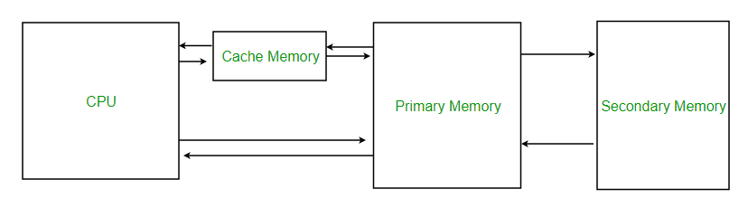

Slide 58
VIRTUAL MEMORY
Virtual memory is a memory management capability of an operating system (OS) that uses hardware and software to allow a computer to compensate for physical memory shortages by temporarily transferring data from random access memory (RAM) to disk storage. Virtual address space is increased using active memory in RAM and inactive memory in hard disk drives (HDDs) to form contiguous addresses that hold both the application and its data.

Slide 59
Magnetic disk
The primary computer storage device. Like tape, it is magnetically recorded and can be re-recorded over and over. Disks are rotating platters with a mechanical arm that moves a read/write head between the outer and inner edges of the platter's surface. It can take as long as one second to find a location on a floppy disk to as little as a couple of milliseconds on a fast hard disk. See hard disk for more details. Tracks and Spots The disk surface is divided into concentric tracks (circles within circles). The thinner the tracks, the more storage. The data bits are recorded as tiny magnetic spots on the tracks. The smaller the spot, the more bits per inch and the greater the storage. Sectors Tracks are further divided into sectors, which hold a block of data that is read or written at one time; for example, READ SECTOR 782, WRITE SECTOR 5448. In order to update the disk, one or more sectors are read into the computer, changed and written back to disk. The operating system figures out how to fit data into these fixed spaces.

Slide 60
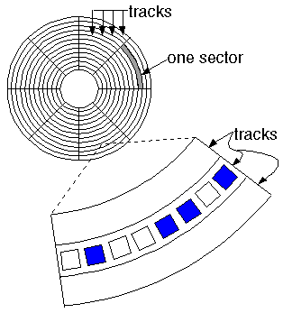

Slide 61
Magnetic tape
Magnetic tape is a medium for magnetic recording, made of a thin, magnetizable coating on a long, narrow strip of plastic film. It was developed in Germany in 1928, based on magnetic wire recording. Devices that record and play back audio and video using magnetic tape are tape recorders and video tape recorders respectively. A device that stores computer data on magnetic tape is known as a tape drive.

Slide 62
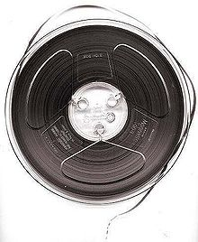
7-inch reel of ¼-inch-wide audio recording tape, typical of consumer use in the 1950s–70s

Slide 63
OPTICAL MEMORY
Optical storage is the storage of data on an optically readable medium. Data is recorded by making marks in a pattern that can be read back with the aid of light, usually a beam of laser light precisely focused on a spinning optical disc. An older example of optical storage that does not require the use of computers, is microform. There are other means of optically storing data and new methods are in development. An optical disc drive is a device in a computer that can read CD-ROMs or other optical discs, such as DVDs and Blue-ray discs. Optical storage differs from other data storage techniques that make use of other technologies such as magnetism, such as floppy disks and hard disks, or semiconductors, such as flash memory and RAM.

Slide 64
DVD
Stands for "Digital Versatile Disc." A DVD is a type of optical media used for storing digital data. It is the same size as a CD, but has a larger storage capacity. Some DVDs are formatted specifically for video playback, while others may contain different types of data, such as software programs and computer files. The original "DVD-Video" format was standardized in 1995 by consortium of electronics companies, including Sony, Panasonic, Toshiba, and Philips.

Slide 65
CPU
ORGANISATION

Slide 66
General Register Organization
When we are using multiple general purpose registers, instead of single accumulator register, in the CPU Organization then this type of organization is known as General register based CPU Organization.
In this type of organization, computer uses two or three address fields in their instruction format. Each address field may specify a general register or a memory word .
If many CPU registers are available for heavily used variables and intermediate results, we can avoid memory references much of the time, thus vastly increasing program execution speed, and reducing program size

Slide 67
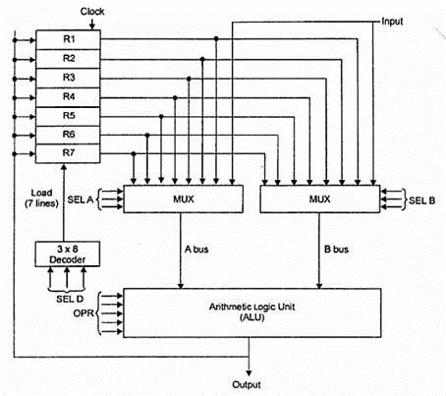

Slide 68
Stack Organization
The computers which use Stack-based CPU Organization are based on a data structure called stack. The stack is a list of data words. It uses Last In First Out (LIFO) access method which is the most popular access method in most of the CPU. A register is used to store the address of the topmost element of the stack which is known as Stack pointer (SP). In this organization, ALU operations are performed on stack data. It means both the operands are always required on the stack. After manipulation, the result is placed in the stack.
The main two operations that are performed on the operators of the stack are Push and Pop. These two operations are performed from one end only.

Slide 69
Instruction Formats (Zero, One, Two and Three Address Instruction)
A instruction is of various length depending upon the number of addresses it contain. Generally CPU organization are of three types on the basis of number of address fields:
* Single Accumulator organization
* General register organization
* Stack organization
Addressing Mode
The term addressing modes refers to the way in which the operand of an instruction is specified. The addressing mode specifies a rule for interpreting or modifying the address field of the instruction before the operand is actually executed.

Slide 70
Zero Address Instructions Address is stored in the opcode , in the zero address instruction. A stack based organization uses zero address instruction.
One Address Instructions This use a implied ACCUMULATOR register for data manipulation. One operand is in accumulator and other is in register or memory location. Implied means that the CPU already know that one operand is in accumulator so there is no need to specify it. i.e there will be one opcode field and one address field.

Slide 71
Two Address Instructions Here two address can be specified in the instruction. Unlike earlier in one address instruction, the result was stored in accumulator here result can be stored at a different location rather than just accumulator, but require the number more of the bit to represent address.
Three Address Instructions This has three address field to specify a register or a memory location. The program created is much short in size but the number of bits per instruction increase.

Slide 72
ADDRESSING MODES
Direct
The operand’s offset is given in the instruction as an 8 bit or 16 bit displacement element. In this addressing mode the 16 bit effective address of the data is the part of the instruction. Here only one memory reference operation is required to access the data.

Slide 73
INDIRECT
This addressing mode utilizes the computer's ability of Segment : Offset addressing .In this mode address field of instruction contains the address of effective address . Here two references are required. 1st reference to get effective address. 2nd reference to access the data. Indirect addressing is generally used for variables containing several elements like, arrays. Starting address of the array is stored in, say, the EBX register.

Slide 74
INDEXED
The address of the operand is obtained by adding to the contents of the general register (called index register) a constant value. The number of the index register and the constant value are included in the instruction code. Index Mode is used to access an array whose elements are in successive memory locations.

Slide 75
IMMIDEATE
In this mode data is present in address field of instruction .Designed like one address instruction format . Limitation in the immediate mode is that the range of constants are restricted by size of address field.

Slide 76
REGISTER
In this addressing mode, a register contains the operand. In this , the operand is placed in one of 8 bit or 16 bit general purpose registers. The data is in the register that is specified by the instruction. Here one register reference is required to access the data.

Slide 77
CONTROL UNIT

Slide 78
Different Instruction Cycle
The Indirect Cycle is always followed by the Execute Cycle. The Interrupt Cycle is always followed by the Fetch Cycle. For both fetch and execute cycles, the next cycle depends on the state of the system.
The Fetch Cycle At the beginning of the fetch cycle, the address of the next instruction to be executed is in the Program Counter(PC).
The Indirect Cycles Once an instruction is fetched, the next step is to fetch source operands. Source Operand is being fetched by indirect addressing it can be fetched by any addressing mode, here its done by indirect addressing). Register-based operands need not be fetched. Once the opcode is executed, a similar process may be needed to store the result in the main memory.

Slide 79
The Execute Cycle
The other three cycles(Fetch, Indirect and Interrupt) are simple and predictable. Each of them requires a simple, small and fixed sequence of micro-operations. In each case, the same micro-operation is repeated each time around. Execute Cycle is different from them. Like, for a machine with N different opcodes there are N different sequences of micro-operations that can occur.
The Interrupt Cycle
At the completion of the Execute Cycle, a test is made to determine whether any enabled interrupt has occurred or not. If an enabled interrupt has occurred then Interrupt Cycle occurs. The nature of this cycle varies greatly from one machine to another.

Slide 80
Instruction cycle
Registers Involved In Each Instruction Cycle:
Memory address registers(MAR)
It is connected to the address lines of the system bus. It specifies the address in memory for a read or write operation.
Memory Buffer Register(MBR)
It is connected to the data lines of the system bus. It contains the value to be stored in memory or the last value read from the memory.
Program Counter(PC)
Holds the address of the next instruction to be fetched.
Instruction Register(IR)
Holds the last instruction fetched.

Slide 81
MICRO PROGRAMMED CONCEPT
A control unit with its binary control values stored as works in memory is called a micro programmed control.
Each word in the control memory contains a microinstruction that specifies one or more micro operations for the system.
Each word in the control memory contains a microinstruction that specifies one or more micro operations for the system.
The micro program is usually fixed at the system design time and so is stored in ROM.
Microprogramming involves placing the representations for combinations of values of control variables in words of ROM.
The contents of a word in ROM at a given address specify the micro operations to be performed for both the data path and the control unit.

Slide 82
THANKS

